Slide 1


Slide 2
BRAINSTORMING

Slide 3
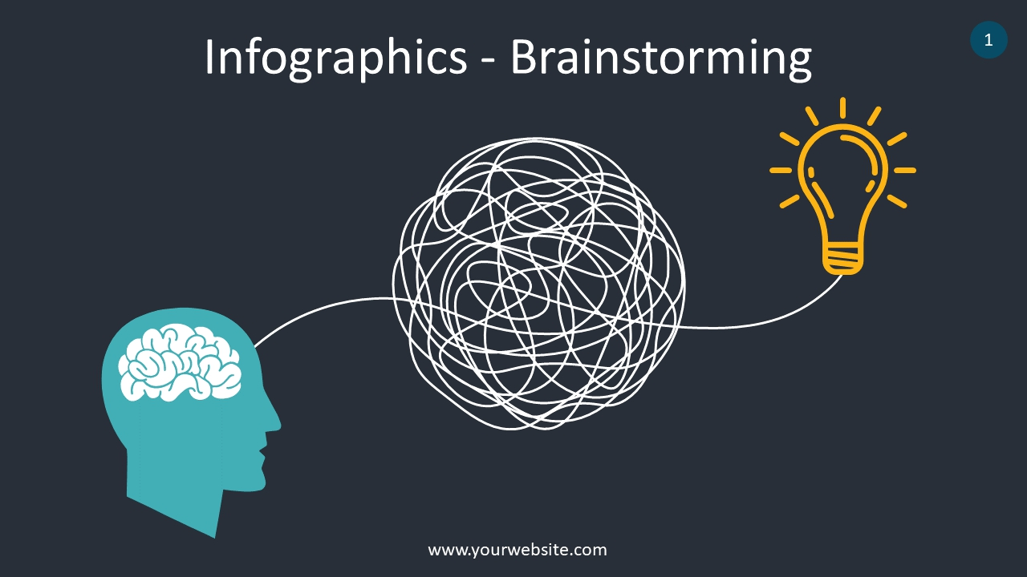
Introduction
Brainstorming is a creative process for generating ideas, solutions, or approaches to a problem through spontaneous and collaborative thinking.

Slide 4
The Brainstorming Process
Steps of brainstorming:
Define the problem or topic.
Encourage idea generation without criticism.
Collect a diverse range of ideas.
Analyze and refine the ideas.

Slide 5
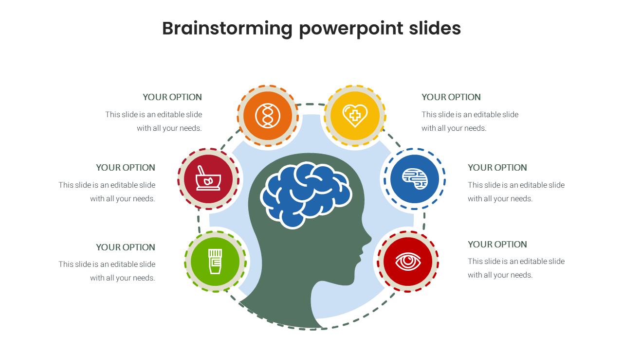
Benefits of Brainstorming
Increased creativity and innovation.
Fosters a collaborative environment.
Enhances problem-solving abilities.
Promotes team engagement and motivation.

Slide 6
Importance of Brainstorming
Encourages creativity and out-of-the-box thinking.
Enhances team communication and collaboration.
Maximizes problem-solving efficiency.
Drives innovation and competitive advantage.

Slide 7
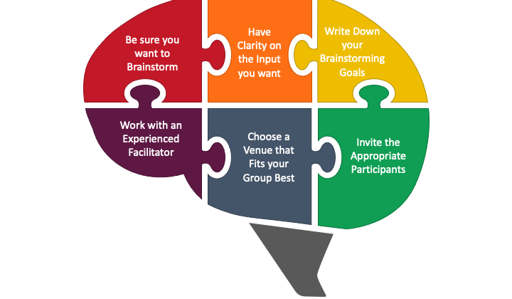
Techniques for Effective Brainstorming
Mind mapping
SWOT analysis
Rolestorming
SCAMPER technique
Substitute Combined Adapt Modify Purpose Eliminate Reverse or Rearrange

Slide 8

Individual Brainstorming
Individual brainstorming is a personal creative process for generating ideas, solutions, or concepts by an individual, often in solitude

Slide 9
The Individual Brainstorming Process
Steps of individual brainstorming:
Choose a quiet and comfortable space.
Clearly define the problem or objective.
Set a time limit for brainstorming.
Generate as many ideas as possible without self-judgment.

Slide 10
Benefits of Individual Brainstorming
Allows for uninterrupted focus and concentration.
Provides privacy and freedom to explore unique ideas.
Encourages deep introspection and self-discovery.
Builds self-confidence in generating creative solutions.

Slide 11
Importance of Individual Brainstorming
Enables personal innovation and creativity.
Fosters independence in idea generation.
Enhances critical thinking and self-reflection.
Complements group brainstorming by adding diverse perspectives.

Slide 12

Techniques for Effective Individual Brainstorming
Mind mapping
Freewriting or journaling
Visualization exercises
Concept sketching

Slide 13
Tips for Successful Individual Brainstorming
Eliminate distractions.
Stay open to unconventional ideas.
Record all ideas, even seemingly small ones.
Review and refine ideas after the brainstorming session.

Slide 14
Applications of Individual Brainstorming
Personal goal setting and planning
Writing and creative projects
Personal problem-solving and decision-making
Self-improvement and self-development

Slide 15
Why Individual Brainstorming Matters
Cultivates self-reliance and self-expression.
Stimulates unique ideas and perspectives.
Empowers individuals to contribute distinct insights.
Supports personal growth and development.

Slide 16

Group Brainstorming
Group brainstorming is a collaborative process that involves a team or a group of individuals coming together to generate a wide array of ideas, solutions, or concepts for a specific problem or goal.

Slide 17
The Group Brainstorming Process
Steps of group brainstorming:
Formulate a clear problem statement or goal.
Set ground rules for participation and idea generation.
Facilitate the brainstorming session to encourage everyone's input.
Capture and organize all ideas for evaluation and selection.

Slide 18
Benefits of Group Brainstorming
Diverse perspectives lead to comprehensive solutions.
Builds team cohesion and fosters a collaborative culture.
Enhances creativity through idea bouncing and combination.
Allows for immediate feedback and idea refinement.

Slide 19
Importance of Group Brainstorming
Capitalizes on collective knowledge and creativity.
Boosts employee engagement and involvement.
Stimulates innovation and accelerates problem-solving.
Encourages a sense of ownership and commitment to solutions.

Slide 20
Techniques for Effective Group Brainstorming
Traditional brainstorming sessions
Nominal Group Technique (NGT)
Round-robin brainstorming
Brainwriting

Slide 21
Tips for Successful Group Brainstorming
Encourage active participation from all team members.
Foster an open and non-judgmental environment.
Embrace and build upon each other's ideas.
Set a time limit for the session to maintain focus.

Slide 22
Applications of Group Brainstorming
Product development and design
Strategic planning and decision-making
Marketing campaigns and branding initiatives
Process improvement and organizational development

Slide 23
Why Group Brainstorming Matters
Harnesses collective intelligence and creativity.
Promotes a culture of collaboration and cooperation.
Results in more innovative and viable solutions.
Strengthens team relationships and morale.

Slide 24
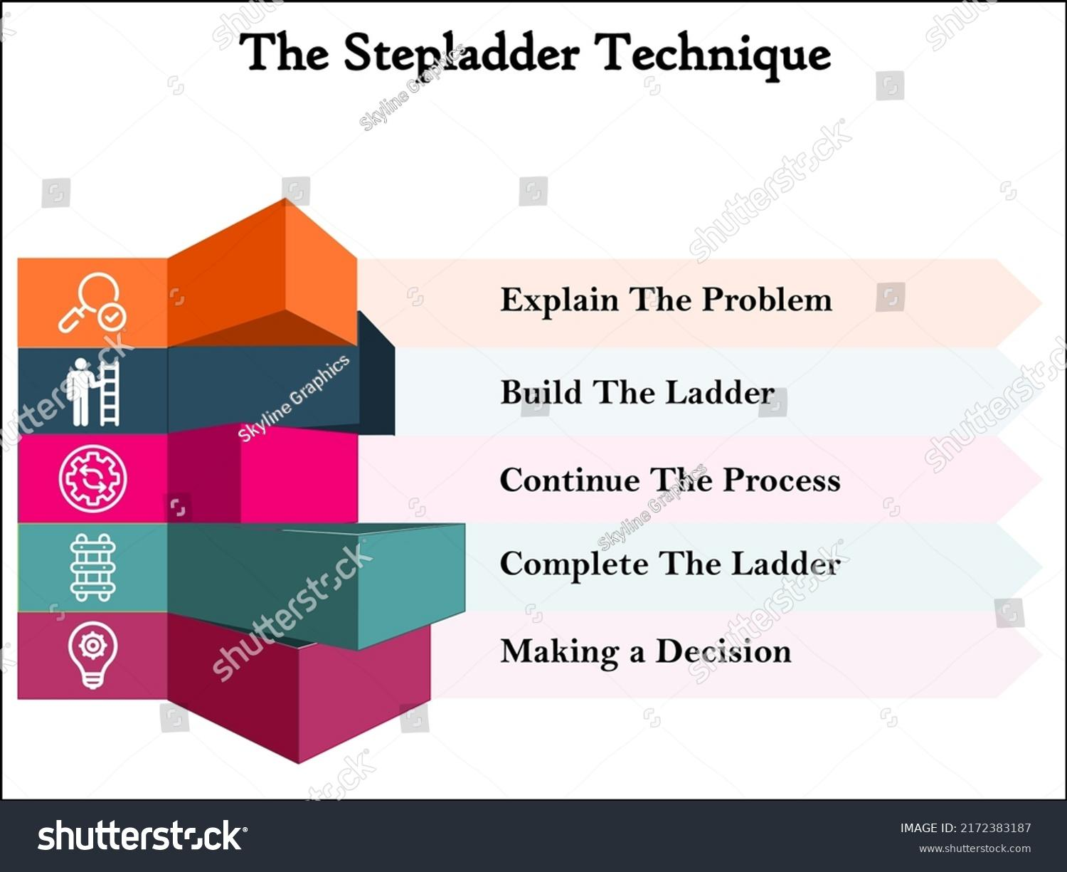
Stepladder Technique
The Stepladder Technique is a method to ensure equal participation in group decision-making, allowing all members to share their ideas without being influenced by initial input from others.

Slide 25
Steps of the Stepladder Technique
Step 1: Individual Preparation
Participants familiarize themselves with the problem or topic and generate initial ideas independently.
Step 2: Pairing
Each member joins the group one-on-one with an existing group member to share their ideas without influence from others.
Step 3: Joining the Triad
Members pair with another existing group member and share both their ideas and those of the first pairing.
Step 4: Joining the Group
The full group discusses and builds upon the ideas shared in the triads.

Slide 26
Benefits of the Stepladder Technique
Ensures equal participation and idea sharing.
Prevents dominant individuals from overshadowing quieter members.
Encourages a diversity of ideas.
Fosters a fair and structured decision-making process.

Slide 27
Applications of the Stepladder Technique
Group brainstorming sessions for problem-solving.
Decision-making in teams or committees.
Strategic planning meetings.
Innovative product development sessions.

Slide 28
Tips for Implementing the Stepladder Technique
Set clear guidelines and expectations for each step.
Assign a facilitator to guide the process and ensure adherence to the technique.
Encourage an open and respectful atmosphere for idea sharing.

Slide 29
Why Use the Stepladder Technique?
Ensures everyone's voice is heard.
Maximizes idea generation and collaboration.
Prevents groupthink and encourages diverse perspectives.

Slide 30
Thank You

